Slide 1
Stack & queue

Slide 2
Kind of structure
Data storage structure that is
Used in database application Array, linked lists, trees, etc
Easy to Insert, Delete and Search
Used as programmer’s tools Stacks, queues, etc
Restricted access
More abstract: underlying mechanism can be array or list, ..

Slide 3
Outline
Stacks
Queues
Priority Queues
Parsing Arithmetic Expressions

Slide 4
Stack

Slide 5

Introduction
Accessible item ?
Last inserted item
Last in, first out (LIFO)
Operations
Push ?
Pop ?
Peek ?
Properties
Stack Overflow (Full)
Stack Underflow (Empty)

Slide 6
Stack info
Info must be managed?
Stack size (is full?)
Number of element (is empty?)
Top item (accessible item)

Slide 7
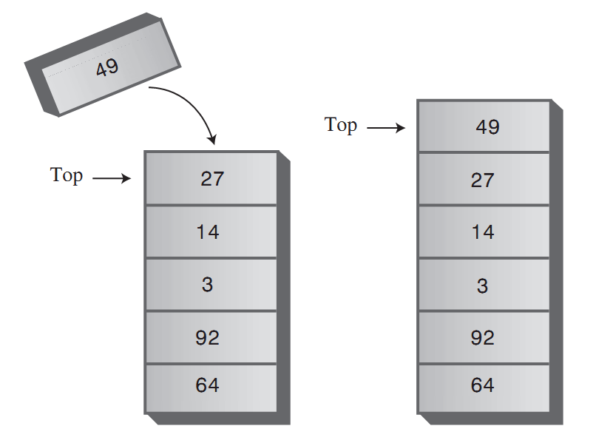
Operations
Push

Slide 8
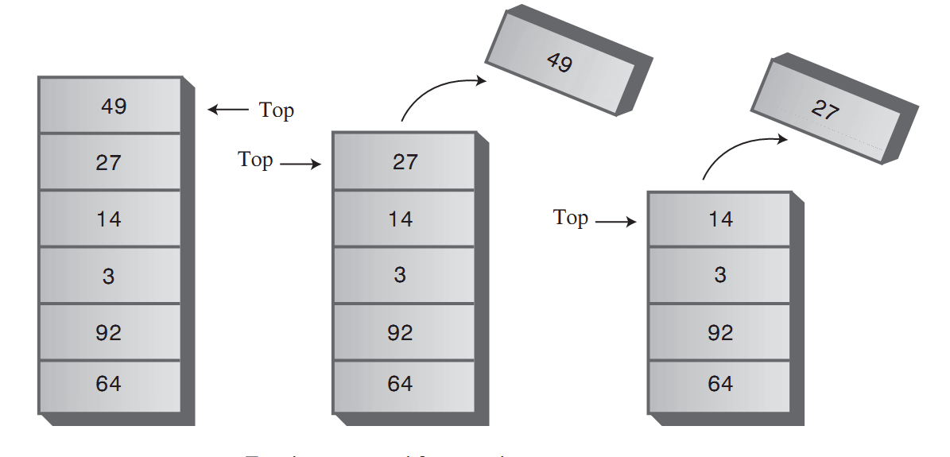
Operations
Pop

Slide 9
Application
Reversing an array/ a word
Delimiter Matching
100 * (100 – 50) → Correct
[100 * (100 – 50)] /2 → Correct
[100 * (100 – 50)} /2 → Incorrect, error on }
[100 * (100 – 50) /2 → Incorrect, error on [
(100 * (100 – 50))) /2 → Incorrect, error on )
100 | 120 | 150 | 200 | 250

Slide 10
How would you do it?
Reversing an array
100 | 120 | 150 | 200 | 250
250
200
150
120
100
250 | 200 | 150 | 120 | 100

Slide 11
How would you do it?
Character Read | Stack contents
( | (
a | (
* | (
[ | ([
b | ([
- | ([
c | ([
] | (
)
/
d
Delimiter Matching
(a * [b – c]) / d

Slide 12
Implementation
See code in page 130

Slide 13
Efficiency of Stacks
Complexity of
Push
Pop
Peek
→ All of them are O(1)

Slide 14
Queue

Slide 15
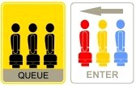
Introduction
Accessible item ?
First inserted item
First in, first out (FIFO)
Tail / Head of queue
Operations
Insert / Enqueue
Remove / Dequeue
Properties
Full
Empty

Slide 16
Queue info
Info must be managed?
Queue size (is full?)
Number of element (is empty?)
Head / tail item (accessible item)

Slide 17
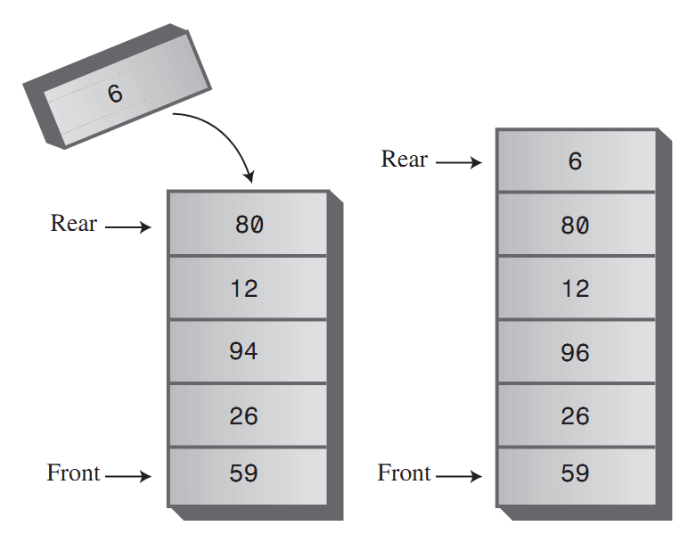
Operations
Enqueue

Slide 18
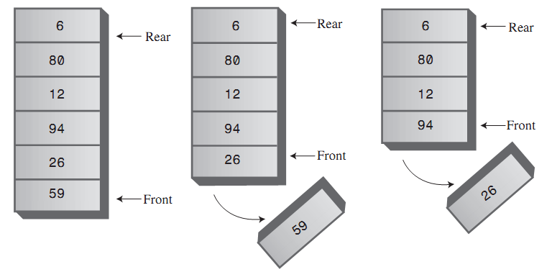
Operations
Dequeue

Slide 19
Application
Printer queue
File queue
Request queue

Slide 20
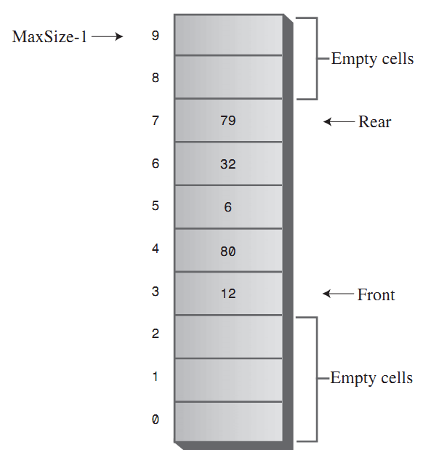
Implementation
Empty cells

Slide 21
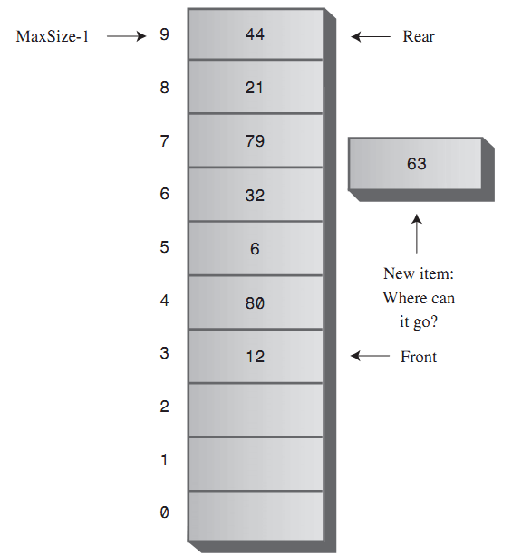
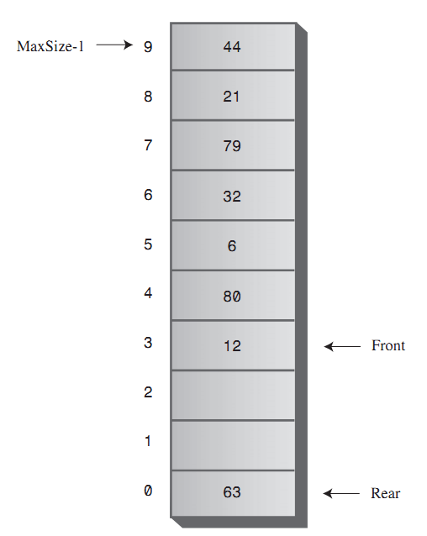
Implementation
Circular queue (Wrap around)

Slide 22
Look at some code
Textbox – p.137

Slide 23
Efficiency of queue
Enqueue?
Dequeue?
→ O(1)

Slide 24
Question
Which of the following is true?
a. The pop operation on a stack is considerably simpler than the remove operation on a queue.
b. The contents of a queue can wrap around, while those of a stack cannot.
c. The top of a stack corresponds to the front of a queue.
d. In both the stack and the queue, items removed in sequence are taken from increasingly high index cells in the array.
Notes:
b

Slide 25
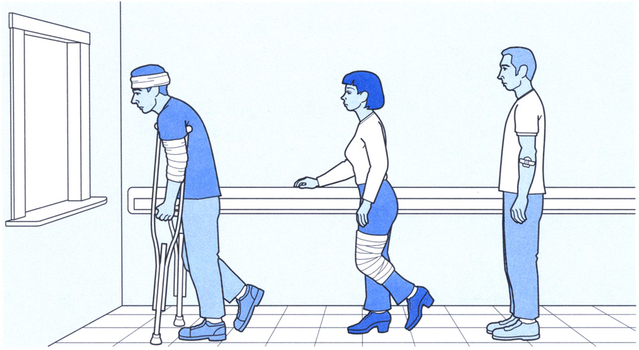
Priority queue
Head / tail
Enqueue / Dequeue with criteria
E.g, dequeue
Highest value, or
Most severe patient, …
Ascending-priority / descending-priority queue

Slide 26
Efficiency of Priority queue
Insertion ?
If use ARRAY: O(N)
Deletion ?
O(1)

Slide 27
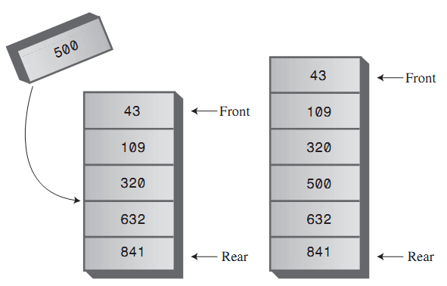
Operation
Enqueue

Slide 28
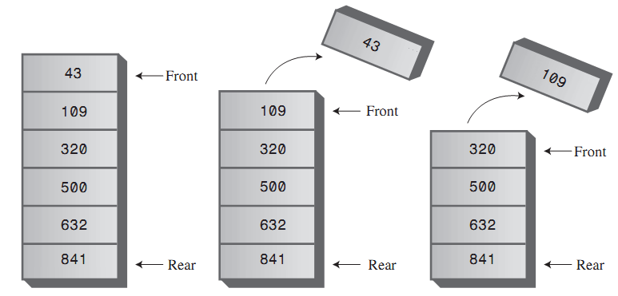
Operation
Dequeue

Slide 29
Question
One difference between a priority queue and an ordered array is that
a. the lowest-priority item cannot be extracted easily from the array as it can from the priority queue.
b. the array must be ordered while the priority queue need not be.
c. the highest priority item can be extracted easily from the priority queue but not from the array.
d. All of the above.
Notes:
b

Slide 30
Parsing Arithmetic Expression

Slide 31
Introduction
How would you evaluate an expression?
3 + 4 - 5
Or (10-5)*2 + (6+4)*3

Slide 32
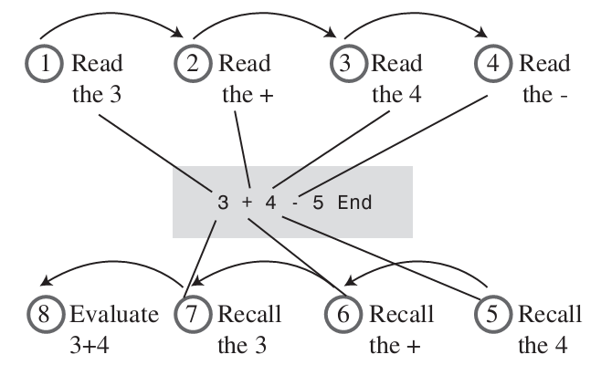
Evaluate 3 + 4 - 5

Slide 33
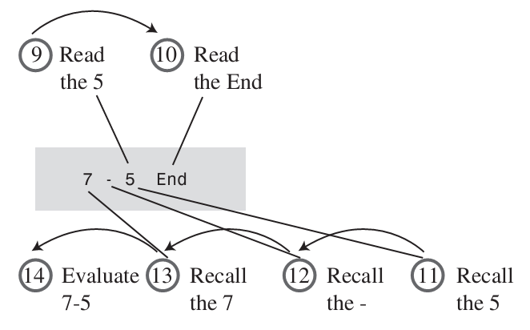
Evaluate 3 + 4 - 5

Slide 34
Algorithm
For computer algorithms:
difficult to evaluate arithmetic expression directly
Solution
Transform arithmetic expression into a different format – POSTFIX
Evaluation the postfix expression

Slide 35
Postfix Notation
To develop a string where the operators (*, -, +,…) appear ‘last’ (hence the term: postfix).
e.g. ab+.
Also known as Reverse Polish Notation
Normally use infix notation
a+b.
Most of the operators we use are binary.
There is also a ‘prefix’ notation, which has more limited applications.

Slide 36
Infix and postfix notations
In postfix notation, an operator operates on the two previous operands. That is the rule.

Slide 37
Table: infix to postfix notations
Parentheses override normal hierarchical evaluation
Infix | Postfix
a+b-c | ab+c-
a*b/c | ab*c/
a+b*c | abc*+
a*b+c | ab*c+
a*(b+c) | abc+*
a*b+c*d | ab*cd*+
((a+b)*c)-d | ab+c*d-
a+b*(c-d/(e+f)) | abcdef+/-*+
Notes:
A-B*C/(D+E)-(F*G)

Slide 38
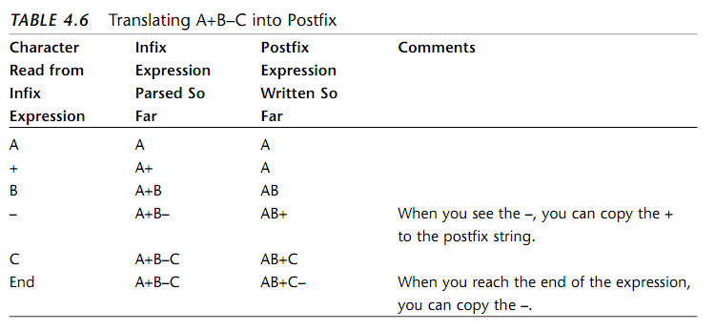
How Humans Translate Infix into Postfix
“-” has the same priority with ‘+’
How about ‘*’ or ‘/’ ?

Slide 39
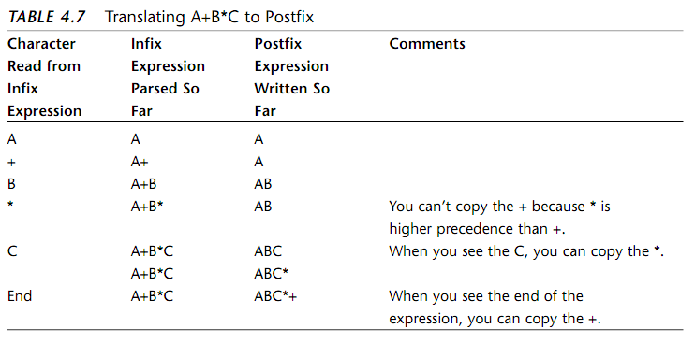
How Humans Translate Infix into Postfix

Slide 40
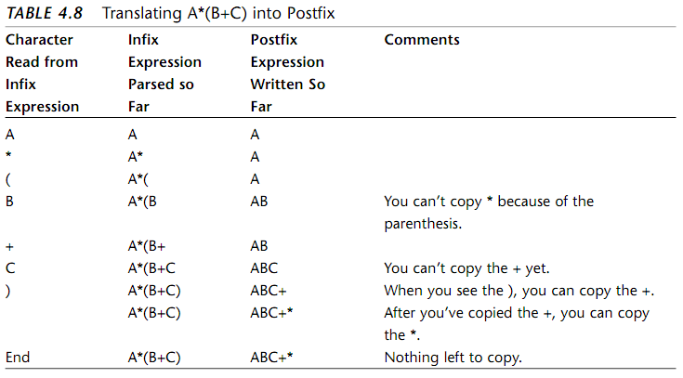
How Humans Translate Infix into Postfix

Slide 41
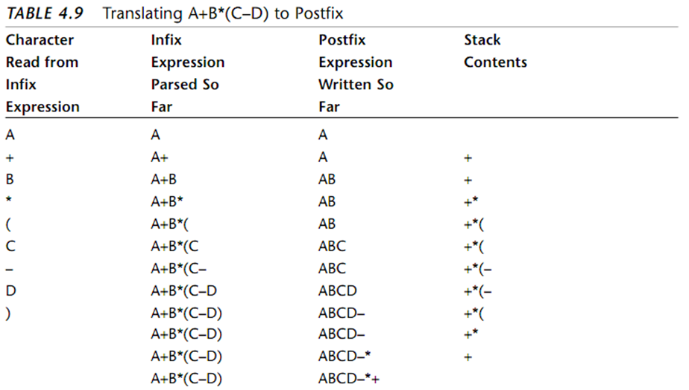
How Humans Translate Infix into Postfix
Saving Operators on a Stack
Notes:
Redundancy

Slide 43
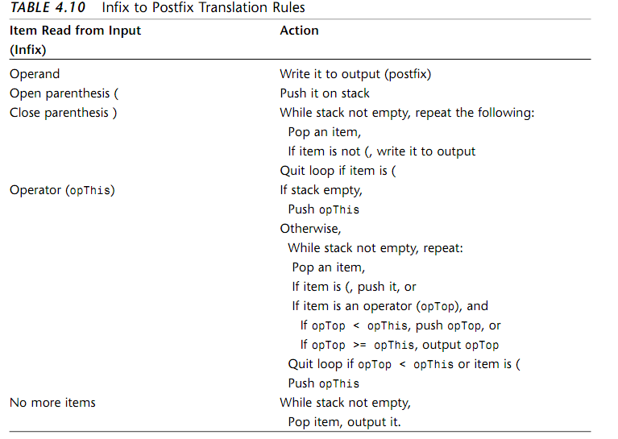

Slide 44
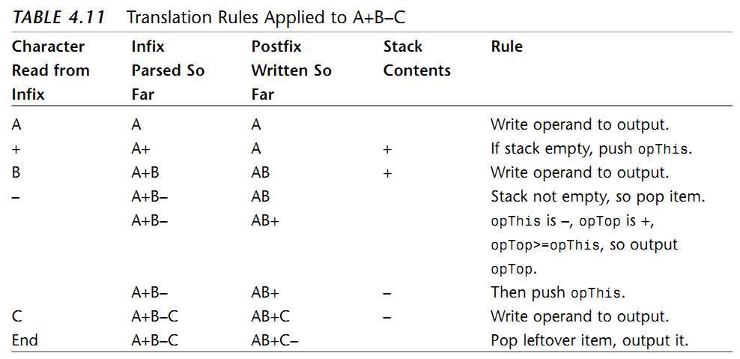
Example

Slide 45
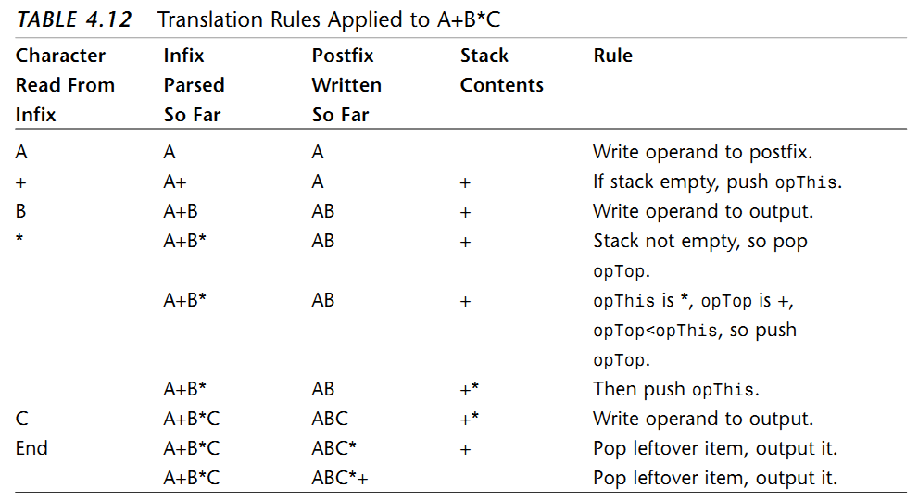
Example

Slide 46
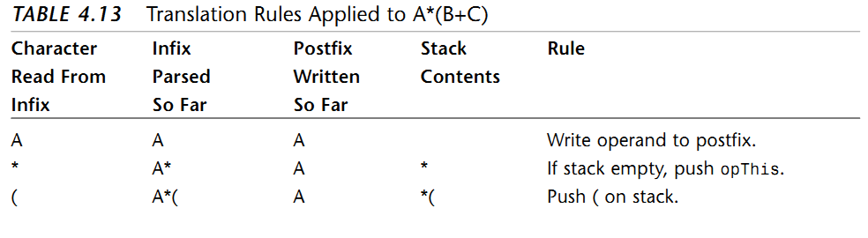
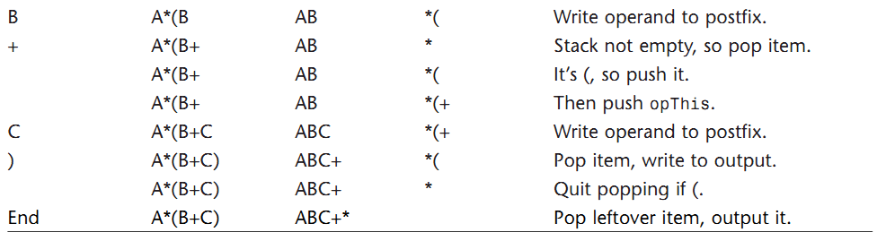
Example

